Slide 1


Results Overview
X
Biochemical Engineering Lab & Janssen Cilag AG
Eduard Meier
Master Thesis Student
18.07.23

Slide 2
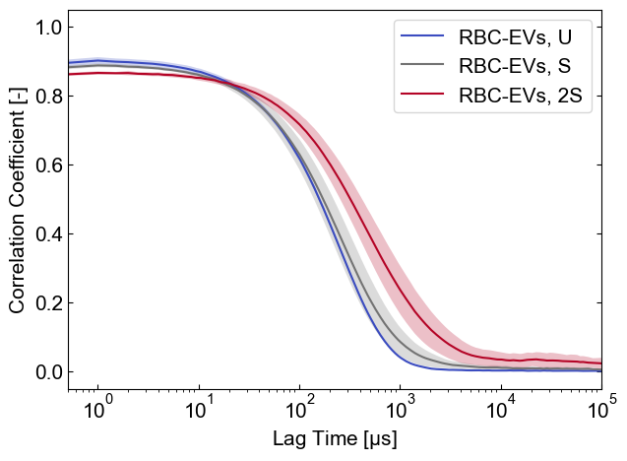
All Plots
Overview Plots

Slide 3
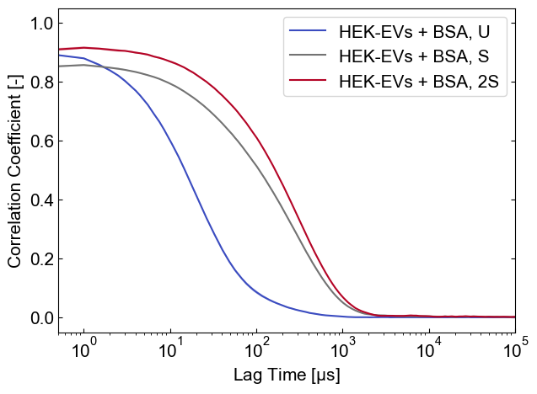
All Plots
Overview Plots

Slide 4
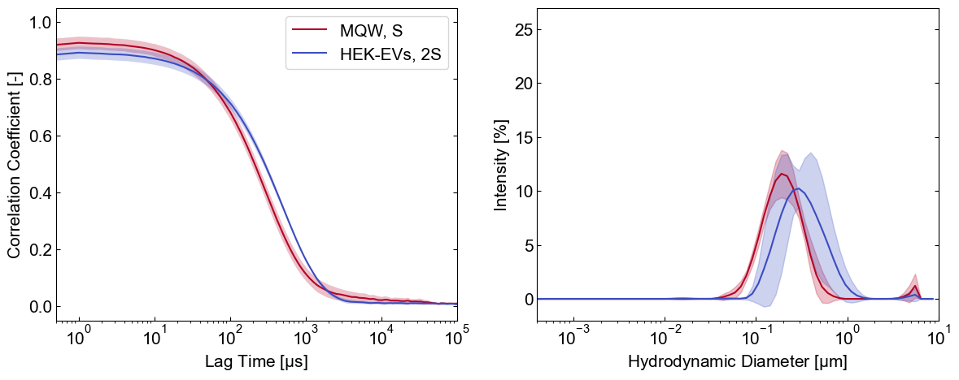
All Plots
Overview Plots

Slide 5
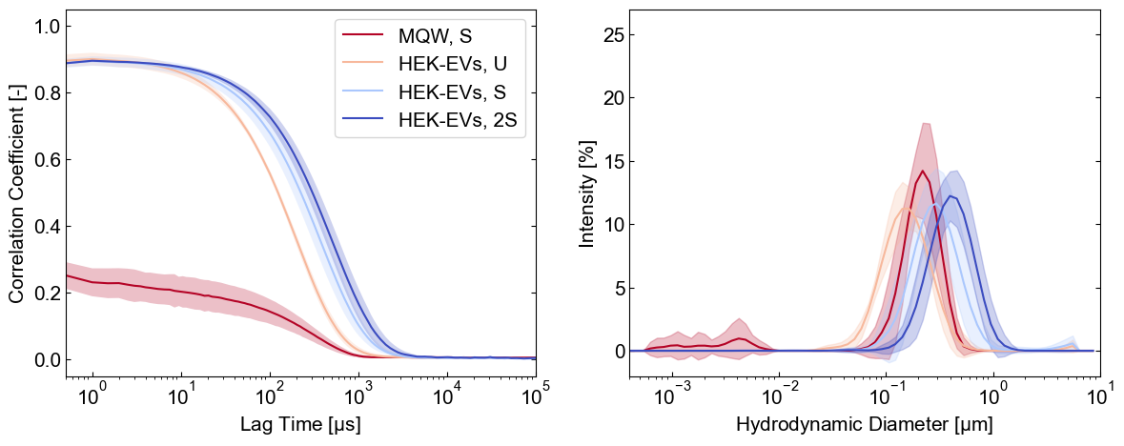
All Plots
Overview Plots

Slide 6
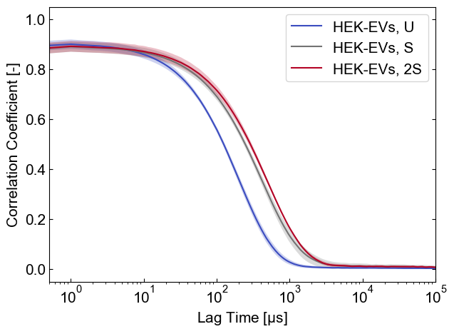
All Plots
Overview Plots

Slide 7
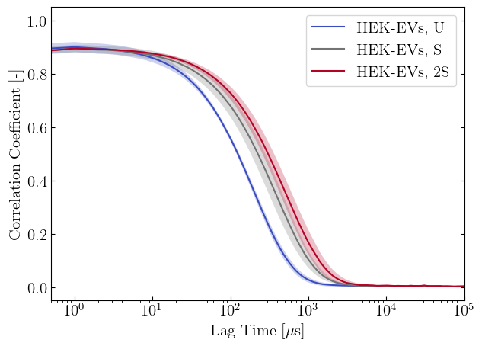
All Plots
Overview Plots

Slide 8
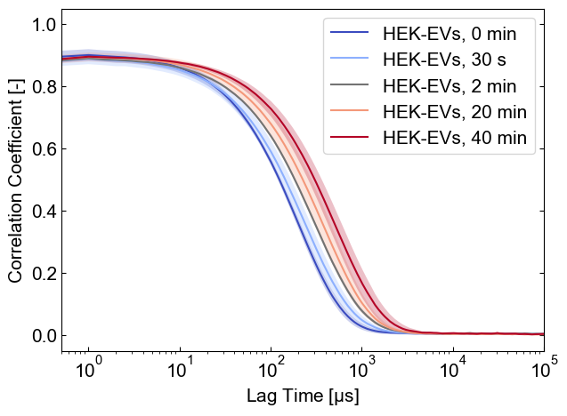
All Plots
Overview Plots

Slide 9
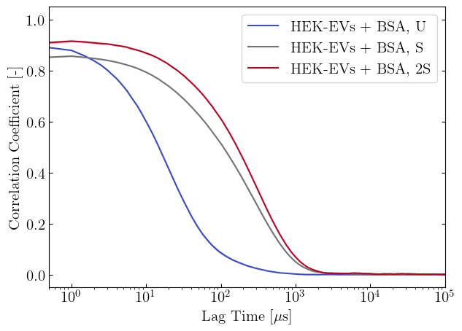
All Plots
Overview Plots

Slide 10
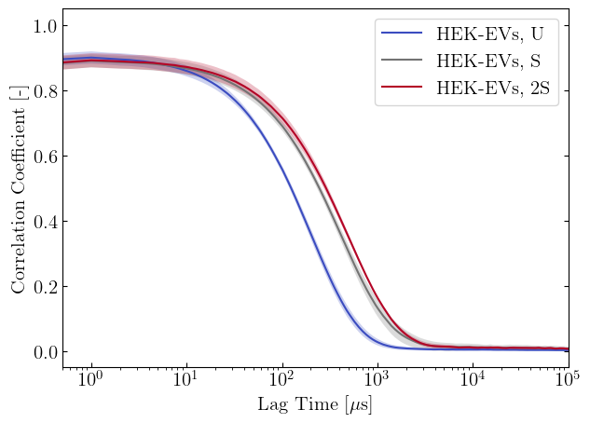
All Plots
Overview Plots

Slide 11
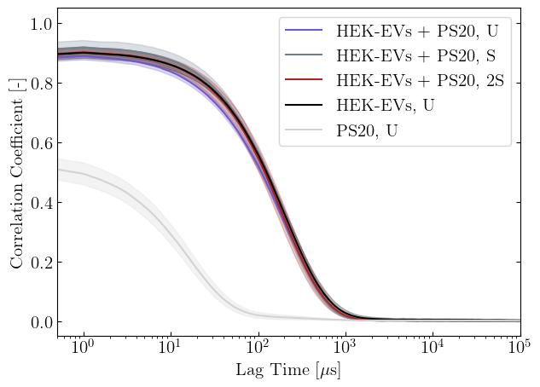
All Plots
Overview Plots

Slide 12
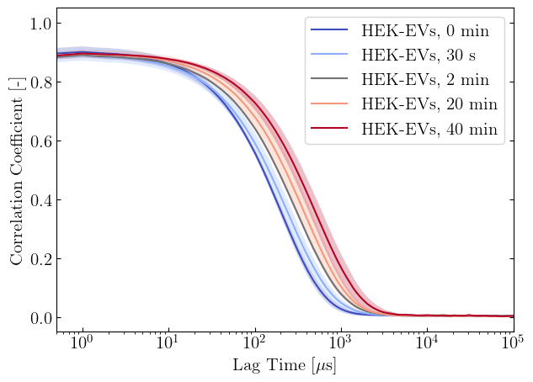
All Plots
Overview Plots

Slide 13
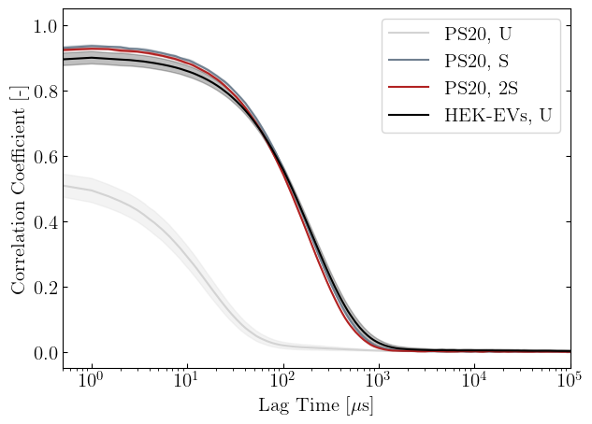
All Plots
Overview Plots

Slide 14
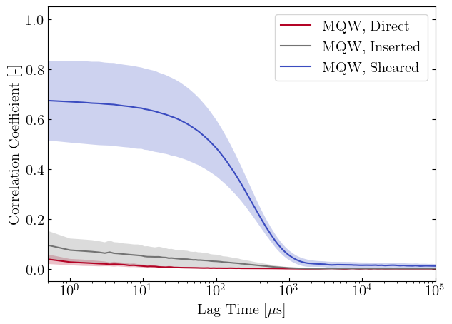
All Plots
Overview Plots

Slide 15
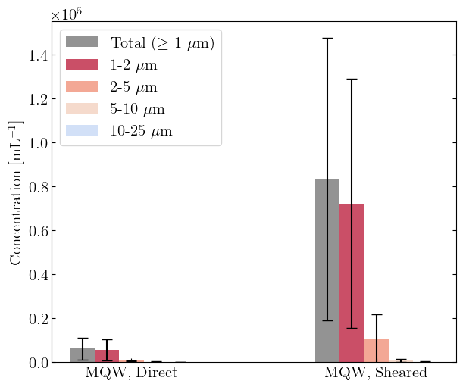
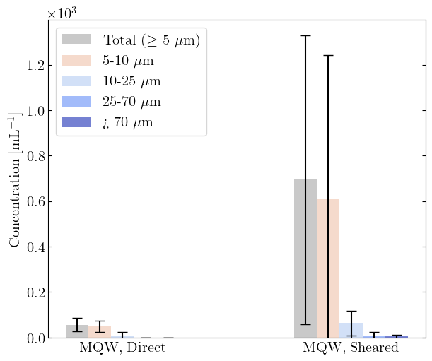
All Plots
Overview Plots

Slide 16
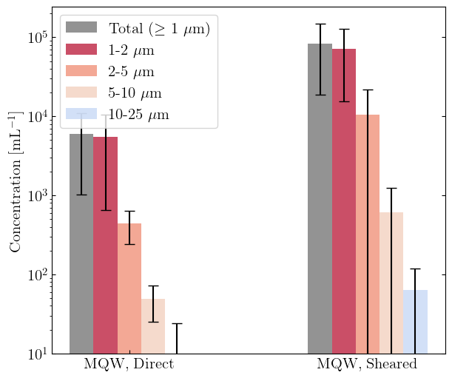
All Plots
Overview Plots

Slide 17
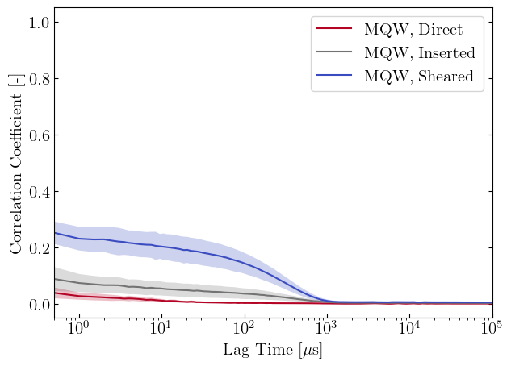
All Plots
Overview Plots

Slide 18
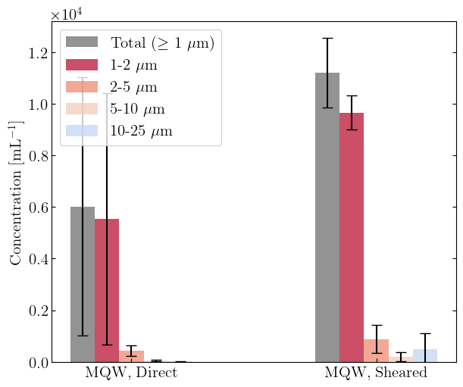
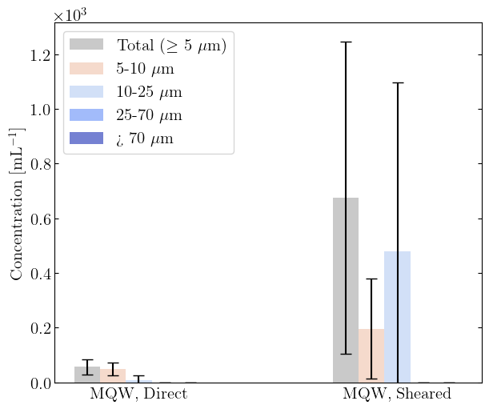
All Plots
Overview Plots

Slide 19
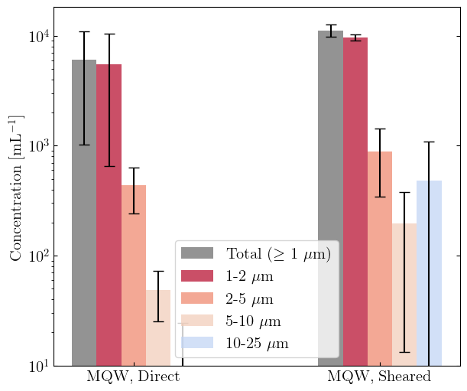
All Plots
Overview Plots

Slide 20
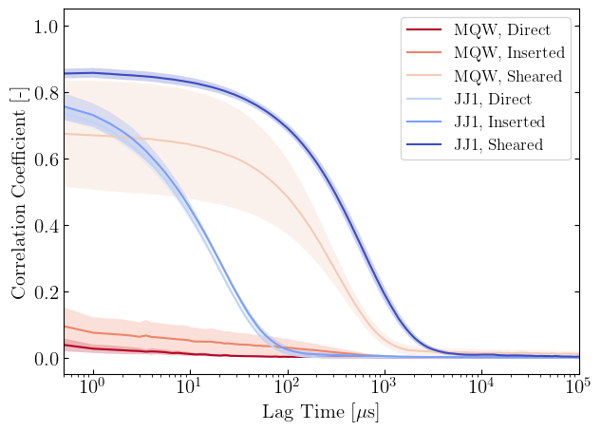
All Plots
Overview Plots

Slide 21
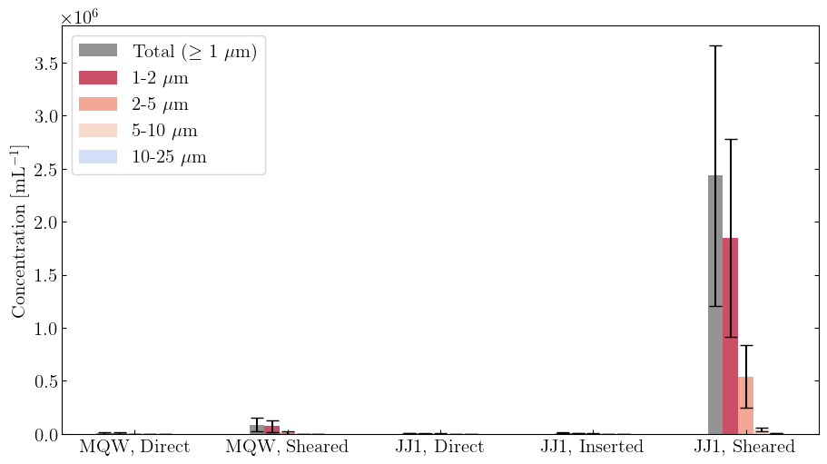
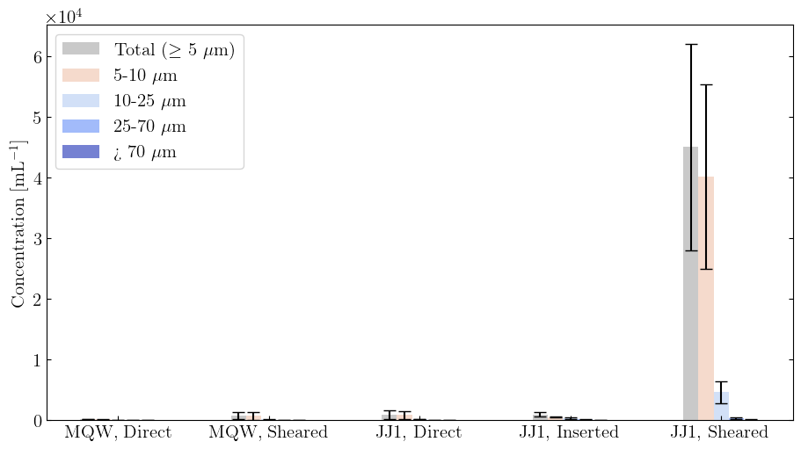
All Plots
Overview Plots

Slide 22
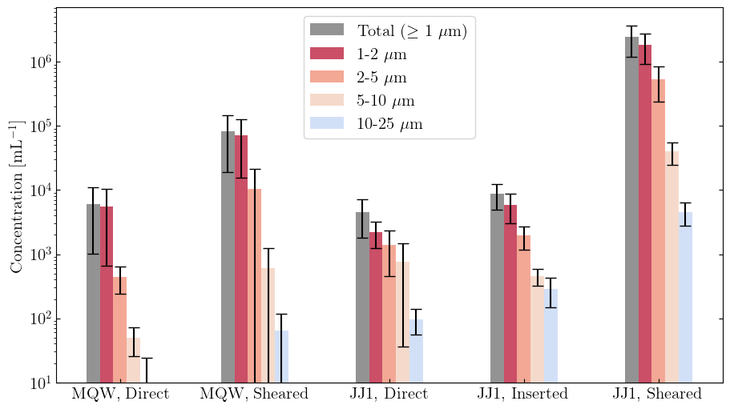
All Plots
Overview Plots

Slide 23
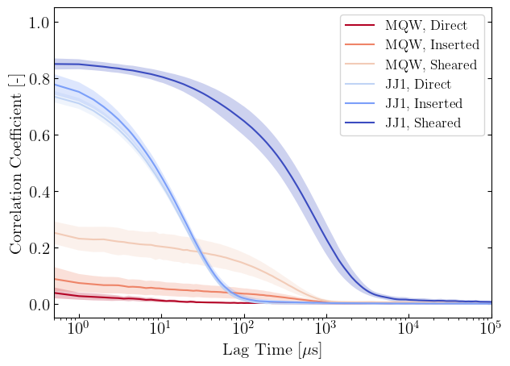
All Plots
Overview Plots

Slide 24
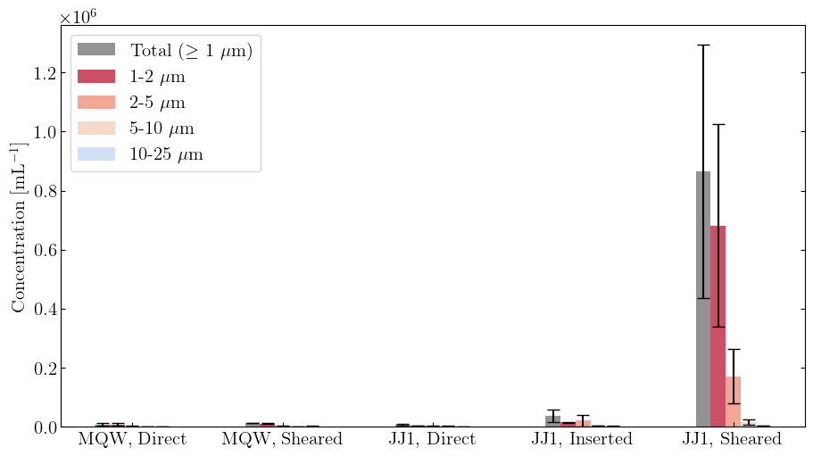
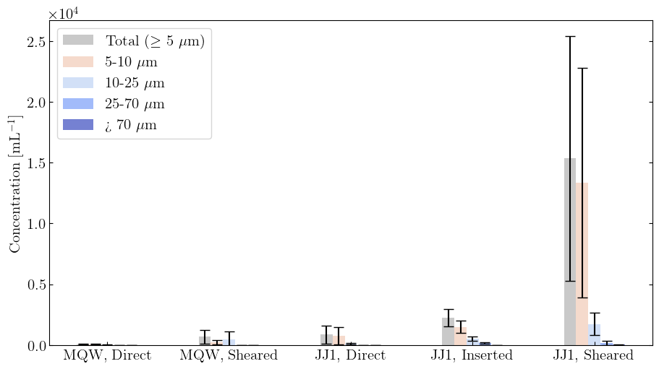
All Plots
Overview Plots

Slide 25
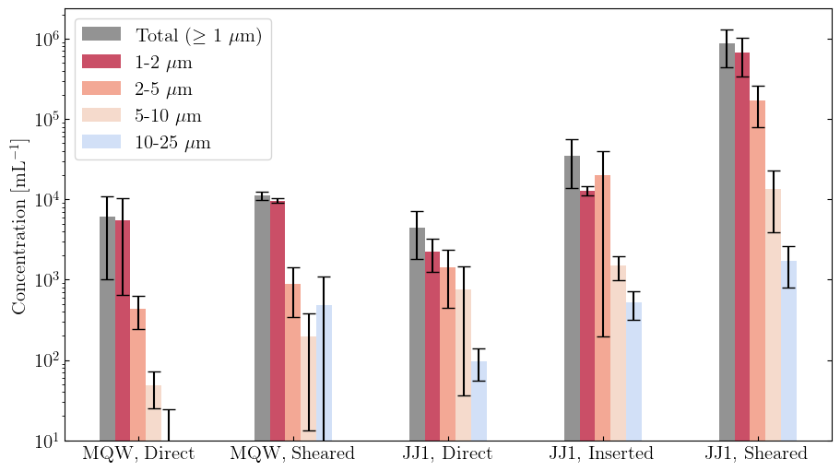
All Plots
Overview Plots

Slide 26
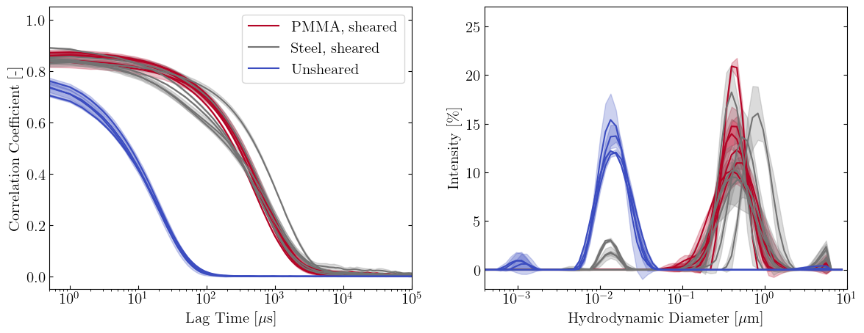
All Plots
Overview Plots

Slide 27
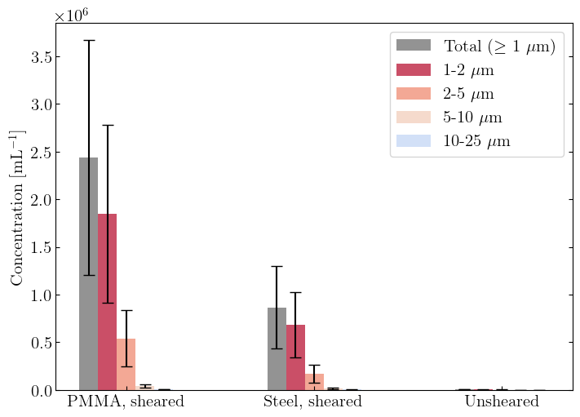
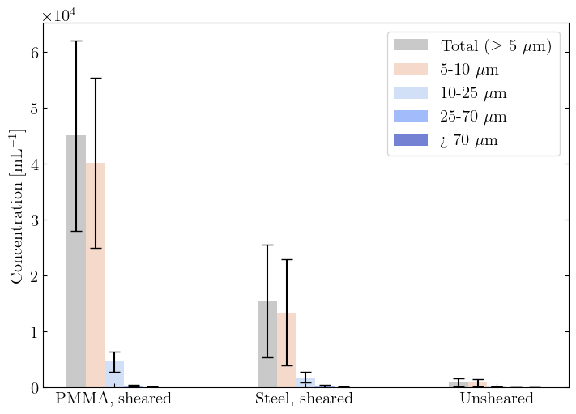
All Plots
Overview Plots

Slide 28
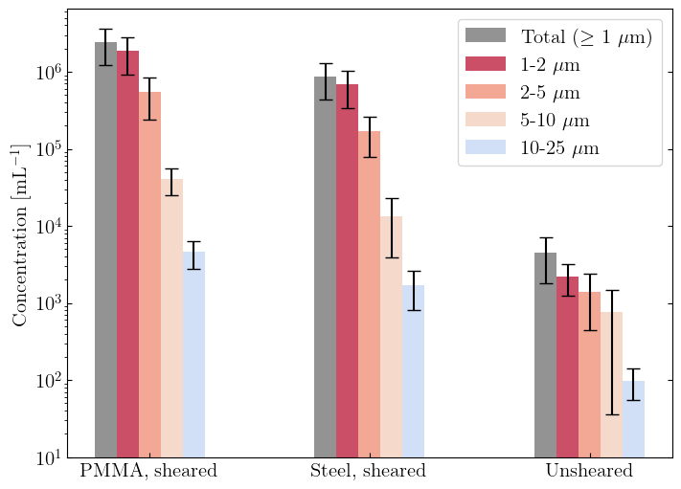
All Plots
Overview Plots

Slide 29
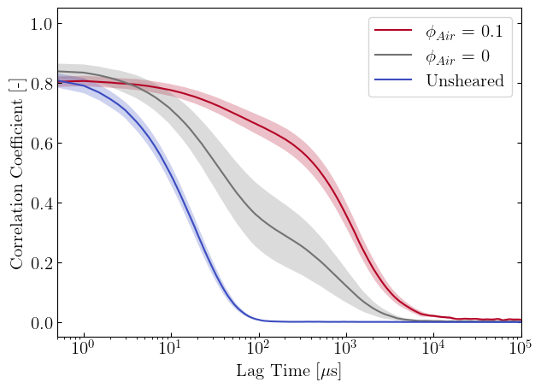
All Plots
Overview Plots

Slide 30
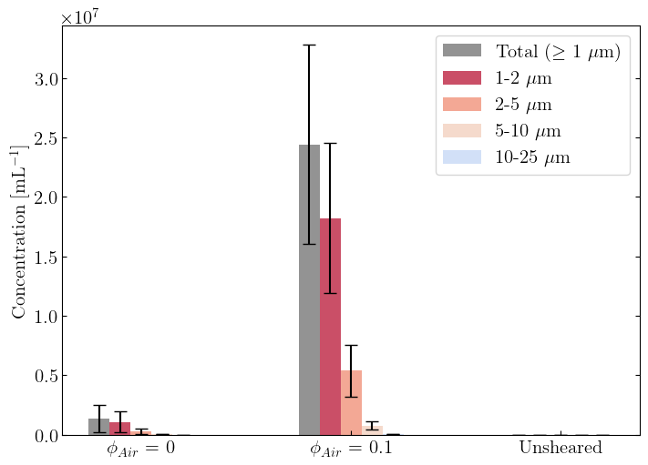
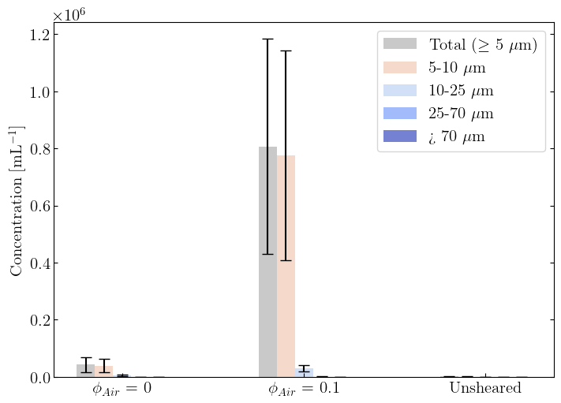
All Plots
Overview Plots

Slide 31
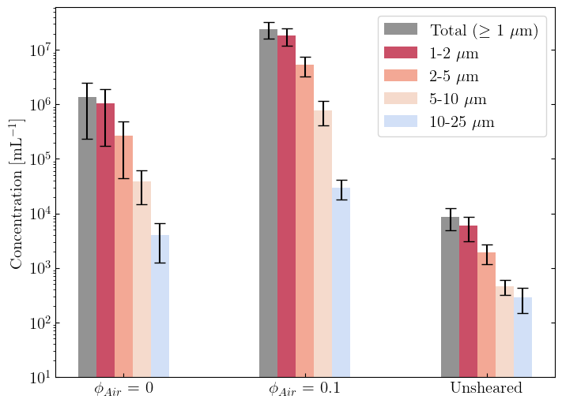
All Plots
Overview Plots

Slide 32
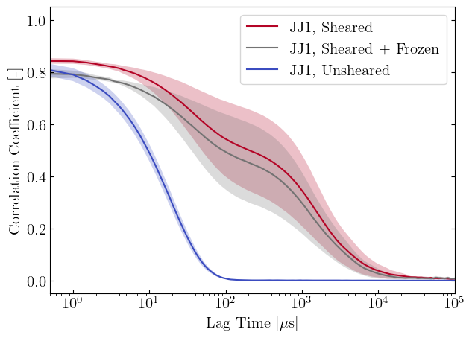
All Plots
Overview Plots

Slide 33
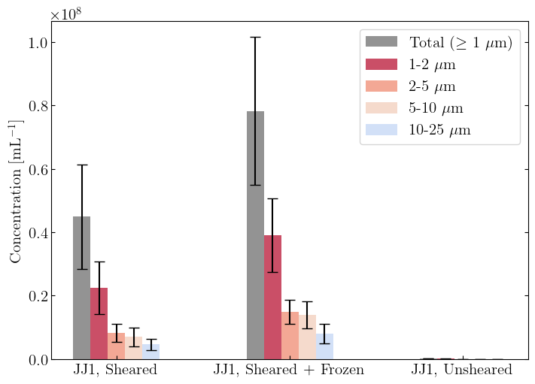
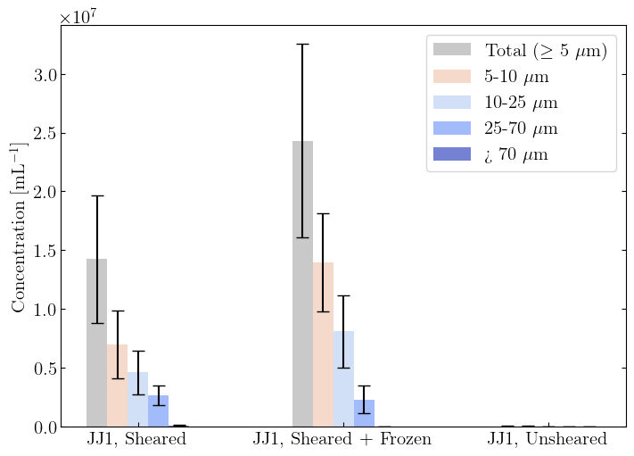
All Plots
Overview Plots

Slide 34
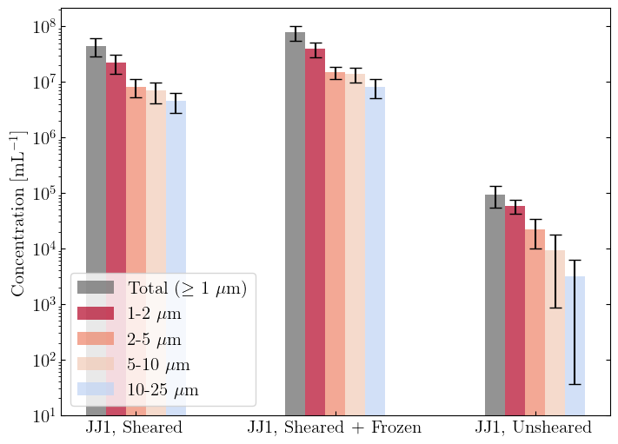
All Plots
Overview Plots

Slide 35
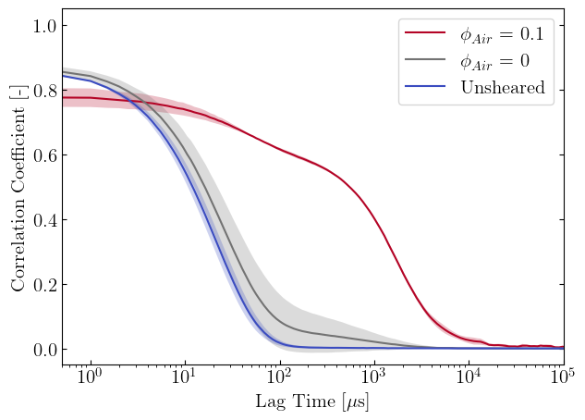
All Plots
Overview Plots

Slide 36
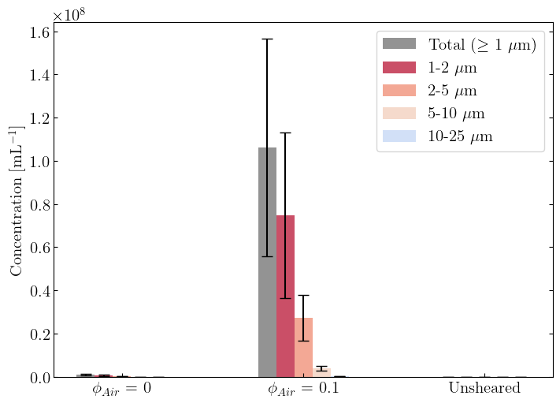
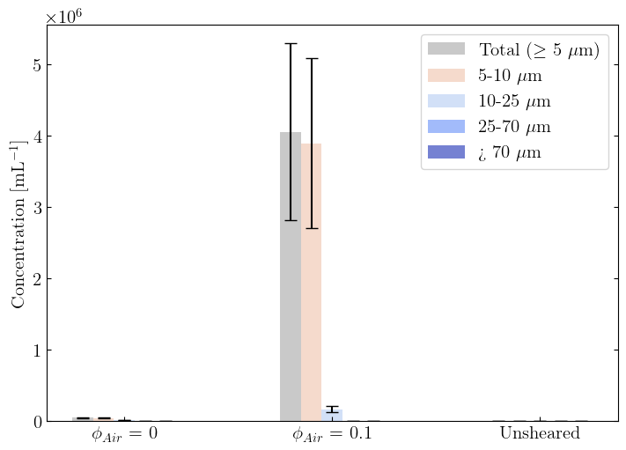
All Plots
Overview Plots

Slide 37
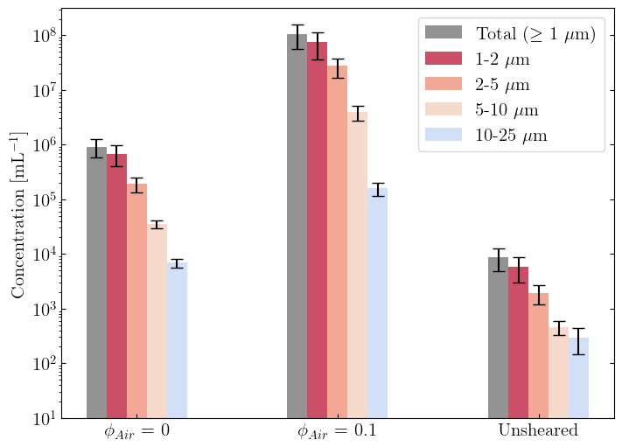
All Plots
Overview Plots

Slide 38
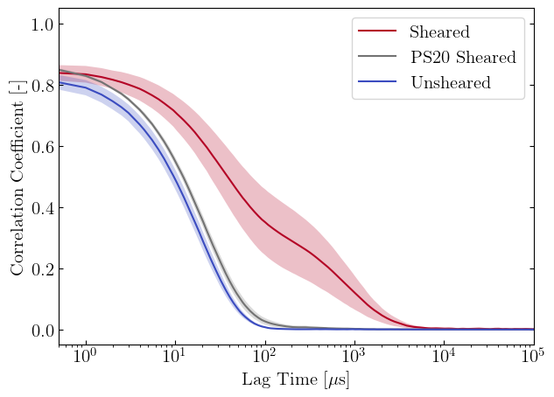
All Plots
Overview Plots

Slide 39
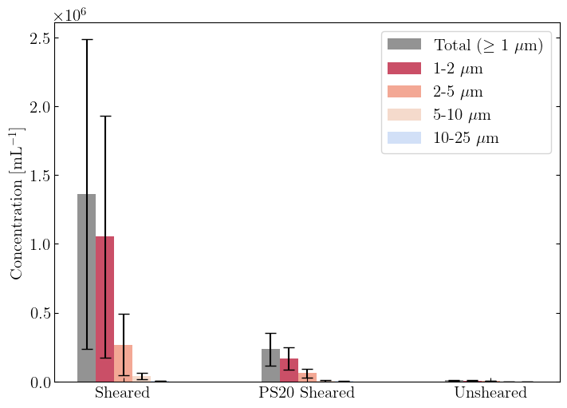
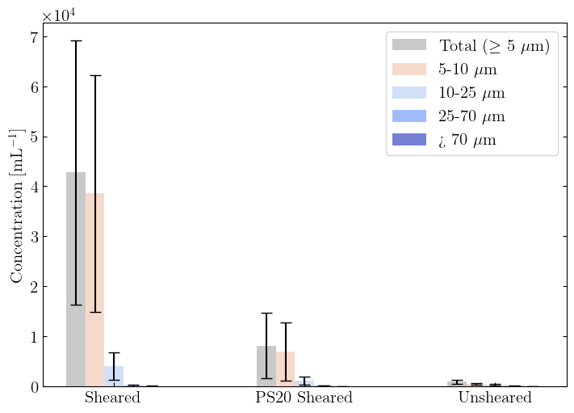
All Plots
Overview Plots

Slide 40
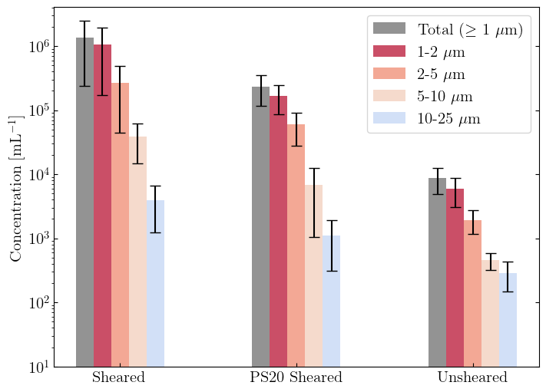
All Plots
Overview Plots

Slide 41
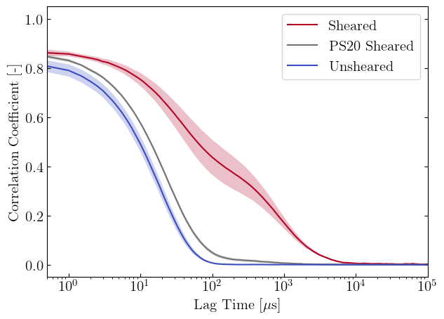
All Plots
Overview Plots

Slide 42
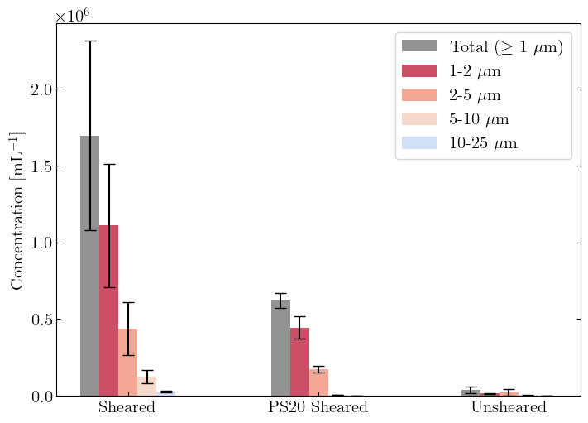

All Plots
Overview Plots

Slide 43

All Plots
Overview Plots

Slide 44

All Plots
Overview Plots

Slide 45


All Plots
Overview Plots

Slide 46

All Plots
Overview Plots

Slide 47

All Plots
Overview Plots

Slide 48


All Plots
Overview Plots

Slide 49

All Plots
Overview Plots

Slide 50

All Plots
Overview Plots

Slide 51


All Plots
Overview Plots

Slide 52

All Plots
Overview Plots

Slide 53

All Plots
Overview Plots

Slide 54


All Plots
Overview Plots

Slide 55

All Plots
Overview Plots

Slide 56

All Plots
Overview Plots

Slide 57


All Plots
Overview Plots

Slide 58

All Plots
Overview Plots

Slide 59

All Plots
Overview Plots

Slide 60


All Plots
Overview Plots

Slide 61

All Plots
Overview Plots

Slide 62

All Plots
Overview Plots

Slide 63


All Plots
Overview Plots

Slide 64

All Plots
Overview Plots

Slide 65

All Plots
Overview Plots

Slide 66


All Plots
Overview Plots

Slide 67

All Plots
Overview Plots

Slide 68

All Plots
Overview Plots

Slide 69


All Plots
Overview Plots

Slide 70

All Plots
Overview Plots

Slide 71

All Plots
Overview Plots

Slide 72


All Plots
Overview Plots

Slide 73

All Plots
Overview Plots

Slide 74

All Plots
Overview Plots

Slide 75


All Plots
Overview Plots

Slide 76

All Plots
Overview Plots

Slide 77

All Plots
Overview Plots

Slide 78


All Plots
Overview Plots

Slide 79

All Plots
Overview Plots

Slide 80

All Plots
Overview Plots

Slide 81


All Plots
Overview Plots

Slide 82

All Plots
Overview Plots

Slide 83

All Plots
Overview Plots

Slide 84


All Plots
Overview Plots

Slide 85

All Plots
Overview Plots

Slide 86

All Plots
Overview Plots

Slide 87


All Plots
Overview Plots

Slide 88

All Plots
Overview Plots

Slide 89

All Plots
Overview Plots

Slide 90


All Plots
Overview Plots

Slide 91

All Plots
Overview Plots

Slide 92

All Plots
Overview Plots

Slide 93


All Plots
Overview Plots

Slide 94

All Plots
Overview Plots

Slide 95

All Plots
Overview Plots

Slide 96


All Plots
Overview Plots

Slide 97

All Plots
Overview Plots

Slide 98

All Plots
Overview Plots

Slide 99


All Plots
Overview Plots

Slide 100

All Plots
Overview Plots

Slide 101

All Plots
Overview Plots

Slide 102


All Plots
Overview Plots

Slide 103

All Plots
Overview Plots

Slide 104

All Plots
Overview Plots

Slide 105


All Plots
Overview Plots

Slide 106

All Plots
Overview Plots

Slide 107

All Plots
Overview Plots

Slide 108


All Plots
Overview Plots

Slide 109

All Plots
Overview Plots

Slide 110

All Plots
Overview Plots

Slide 111


All Plots
Overview Plots

Slide 112

All Plots
Overview Plots

Slide 113

All Plots
Overview Plots

Slide 114

All Plots
Overview Plots

Slide 115

All Plots
Overview Plots

Slide 116

All Plots
Overview Plots

